Slide 1
Textron Cooling Fan Project
Team: Electron Wranglers

Slide 2
Textron
Ayham Sabra
EE
Project Lead
Cody White
EE
Project Manager
Mel St.John
EE
Scribe
We are going to monitor and make sure a BLDC motor stays within our threshold RPM

Slide 3
Ayham Sabra: Environmental/Component Requirements
The Environmental Requirements we have are
Make sure it works in -55 to 85 Celsius
Must be able to operate in altitudes from -1,000 ft to 55,000 ft
Make sure it follows DO 160G sections 6, 8 and 22
Humidity, Vibration and indirect effects of lighting
I have contact both Textron, the library and NAIR for a copy DO-160G
Textron will show us a there copy once we have finished a prototype with all other parts they’re looking for
Haven’t gotten a response for NAIR

Slide 4
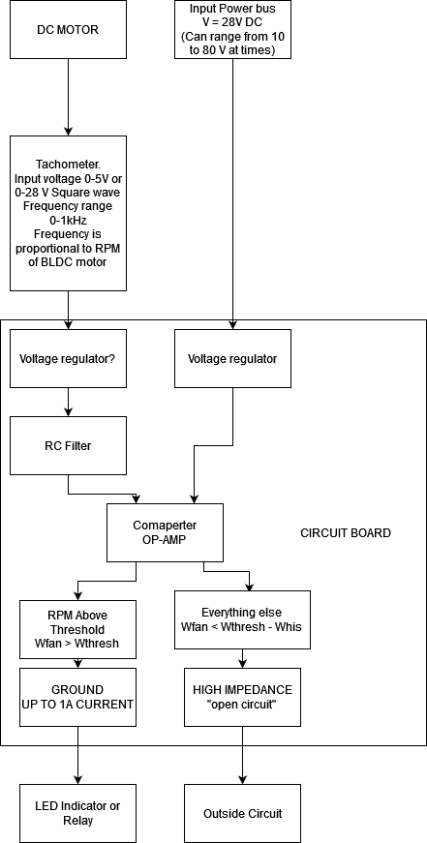
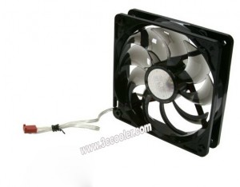
Cody White Input
Receives a power input of 28 V of DC power, but must operate from 10 to 80 V.
Receives a tachometer input that operates from 0 to 5 V or 0 to 28 V.
The Tachometer input is a square wave.
Should be able to accept frequencies from 0 to 1 kHz.

Slide 5
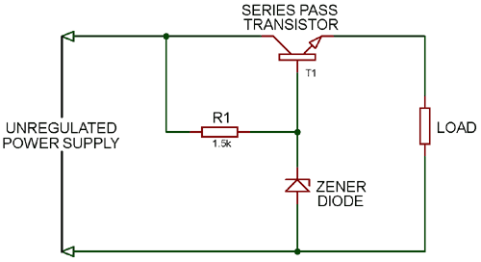
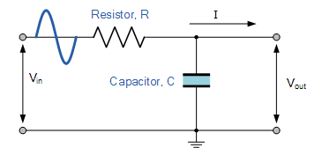
Cody White
Based on research into RC filters, we have determined we’ll need a low pass filter for the tachometer output to create a smooth signal.
Based on research into voltage regulators, we have determined we’ll need a passive voltage regulator to lower the input coming from the power bus.

Slide 6
Mel St.John Output
Component Constraints
Make sure to not use programmable chips (No memory in chips)
Other testing required for these chips (DO-178 and/or DO-254)
Make sure components are generic and can’t easily go obsolete
O/P goes to ground if Rpm above threshold
O/P provides an open if Rpm below threshold
Sink 1 amp continuously when providing ground
Should incorporate hysteresis

Slide 7
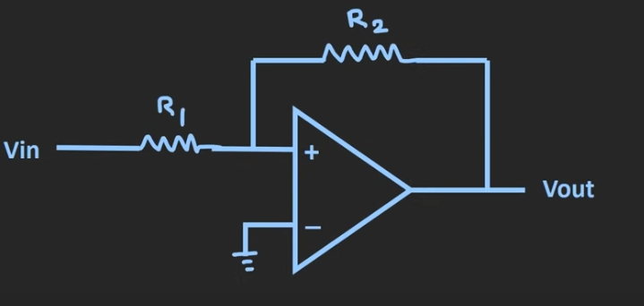
Mel St.John
Comparator- Schmitt Trigger (with Hysteresis Feedback)

Slide 8
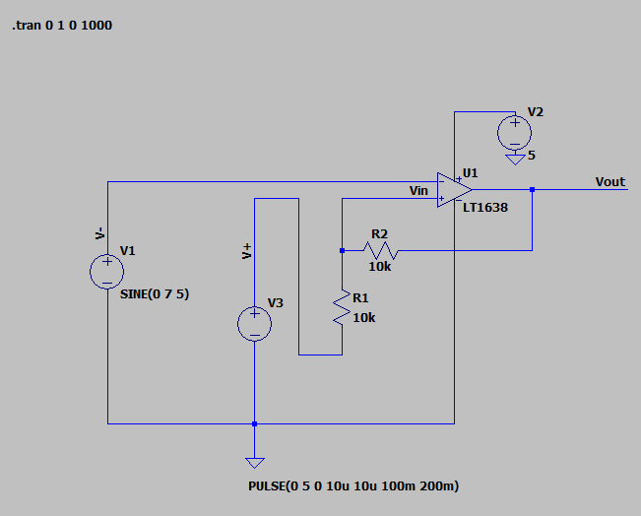
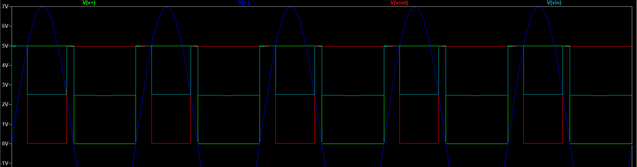
Ayham Sabra
Schmitt Trigger Comparator Circuit in LTspice

Slide 9
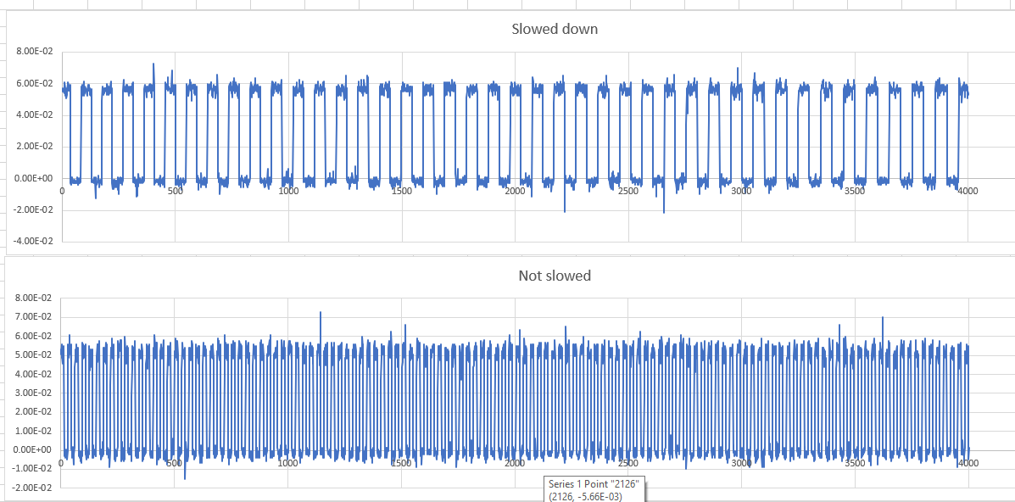
Ayham Sabra
Fan Tachometer measurements

Slide 10
Thank you

Slide 11
https://www.3ccooler.com/cooler-master-12025-a12025-20rb-3bn-f1-df1202512rfun-r4-l2r-20ac-gp-12v-0-37a-3-wires-led-cooler-fan.html#product-details-tab-specification

